Slide 1


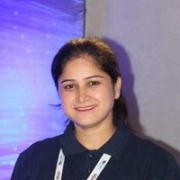




Speaker
Vandana Verma Sehgal
Embracing Developer-First Security for the Cloud Era
Embracing Developer friendly security with automation
Vandana Verma Sehgal
InfosecVandana
September 16th & 17th
^{Online Event}
Powered By
International Conference

